Slide 1

AMAZON
SALES
ANALYSIS
RUPAL KANCHAN
~Data Analyst Intern

Slide 2

PROBLEM STATEMENT
AMAZON is an E-commerce company. And thier Sales management team has gained importance to meet increasing competition and the need for improved methods of distribution to reduce cost and to increase profits.
As Sales management today is the most important function in a commercial and business enterprise.

Slide 3

DETAILS OF DATA
Performed ETL (Extract-Transform-Load) on Amazon dataset to find Sales Trend : Month-wise, Year-wise, Yearly Month-wise.
Found KPIs and factors to show the meaningful relationships between attributes.
Recognizing sales management as the cornerstone of success in the commercial and business landscape.
Showcasing the power of visual representation through a dynamic Power BI dashboard.
Utilizing a diverse set of visualizations, including clustered column charts, line charts, tree maps, filled maps, slicers, and cards, to present a comprehensive view of sales data.
Unearthing insights into monthly and yearly sales trends, unit sales correlations, regional profit dynamics, and order priority analysis.
Enabling strategic decision-making in sales strategies, inventory management, and resource allocation.

Slide 4
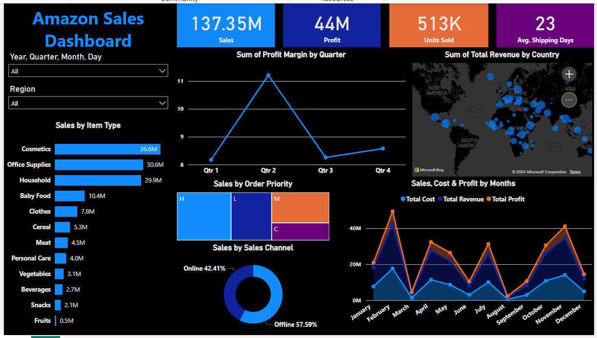
DASHBOARD SNIPPET

Slide 5
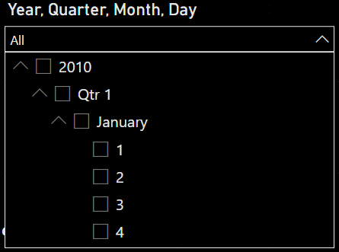
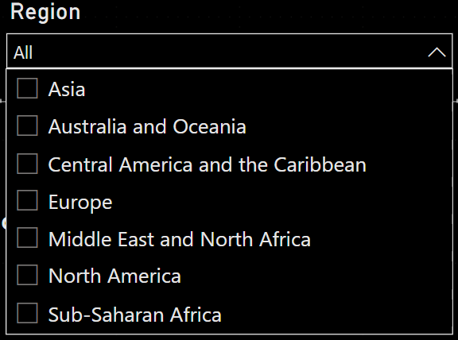
FILTERS IN DASHBOEARD
Filter by
Year> Quarter> Month> Day
Filter by
Regions Amazon is catering

Slide 6

INSIGHTS FROM THE ANALYSIS
Monthly Sales Trends:
Highest sales occurs in February with $24,740,517.77.
Lowest sales occurs in August with $1,128,164.91.
Yearly Sales Trends:
The Highest sales in 2012 with $31,898,644.52.
The Lowest sales in 2015 with $12,427,982.86.
Total Revenue and Costs:
Total Revenue generated from 2010-2017 is $137.35 Million
Total Cost is incurred is $93.18 million
Total Unit Price is $27.68k
Total Unit Cost is $19.10k
Order Priority Analysis:
Order Priority 'H' has sold the most number of units i.e 154,212
Order Priority 'M' has sold the least number of units i.e 94,832
Region-wise Profit Analysis:
Sub-Saharan Africa has generated highest profit in offline sales (approx. $7.8 M) and is the second-highest in online sales.
Europe has the highest profit in online sales (approx. $5.5 M) and the second-highest in offline sales.
Revenue by Item type :
Household Items have the highest Total Revenue in Offline sales approx. $29.7 M
Cosmetics Item have the highest Total Revenue in Online sales approx. $18.3 M

Slide 7



